Slide 1
Direct extraction of path weak values from interferograms without auxiliary qubits
I. V. Masiello¹, A. Dvorak¹, H. Lemmel^{1,2}, and Y. Hasegawa^{1,3}
¹Atominstitut, TU Wien, Stadionallee 2, 1020 Vienna, Austria
²Institut Laue-Langevin, 71 avenue des Martyrs, 38000 Grenoble, France
³Department of Applied Physics, Hokkaido University, Kita-ku, Sapporo 060-8628, Japan

Slide 2
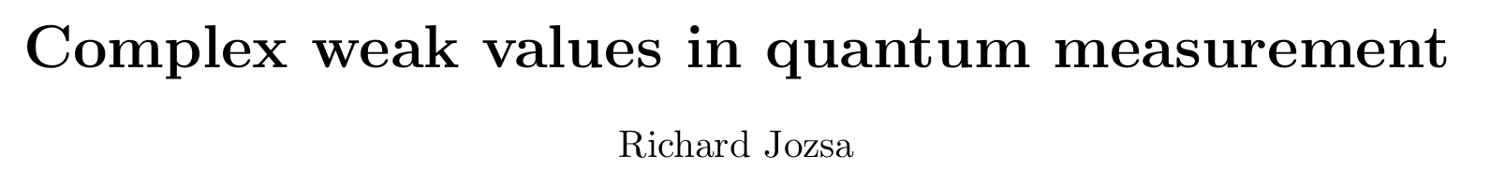
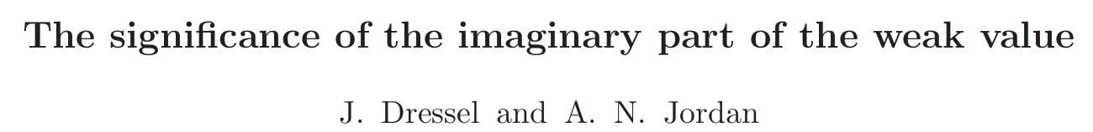
Introduction to weak values
References:

Slide 3


Introduction to weak values
Weak value:

Slide 4
Introduction to weak values
Observable:
Pre-selected state:
Post-selected State:
Weak value:

Slide 5
Introduction to weak values
Observable:
Pre-selected state:
Post-selected State:
Complex number
Not bounded by eigenvalues
Weak value:

Slide 6
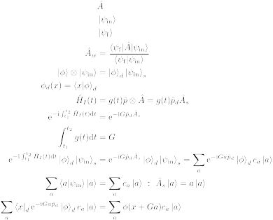
Introduction to weak values
Von Neumann measurement

Slide 7
Introduction to weak values
Von Neumann measurement
Detector
System

Slide 8
Introduction to weak values
Von Neumann measurement
Detector
System

Slide 9
Introduction to weak values
Von Neumann measurement
Interaction
Hamiltonian

Slide 10
Introduction to weak values
Von Neumann measurement
Interaction
Hamiltonian

Slide 11
Introduction to weak values
Von Neumann measurement

Slide 12
Introduction to weak values
Von Neumann measurement

Slide 13
Introduction to weak values
Von Neumann measurement

Slide 14
Introduction to weak values
Von Neumann measurement

Slide 15
Introduction to weak values
Von Neumann measurement

Slide 16
Introduction to weak values
Von Neumann measurement

Slide 17
Introduction to weak values
Von Neumann measurement

Slide 18
Introduction to weak values
Von Neumann measurement
Translation operator

Slide 19
Introduction to weak values
Von Neumann measurement
Position
projection

Slide 20
Introduction to weak values
Von Neumann measurement
Position
projection

Slide 21


Introduction to weak values
Stern-Gerlach:
Position
Spin

Slide 22

Introduction to weak values
Stern-Gerlach:
Position
Spin
N
S

Slide 23
Introduction to weak values
Stern-Gerlach:
Position
Spin
N
S

Slide 24
Introduction to weak values
Weak measurement:

Slide 25
Introduction to weak values
Weak measurement:

Slide 26
Introduction to weak values
Weak measurement:

Slide 27
Introduction to weak values
Weak measurement:

Slide 28
Introduction to weak values
Weak measurement:

Slide 29
Introduction to weak values
Weak measurement:

Slide 30
Introduction to weak values
Weak measurement:

Slide 31
Introduction to weak values
Weak measurement:

Slide 32
Introduction to weak values
Weak measurement:

Slide 33
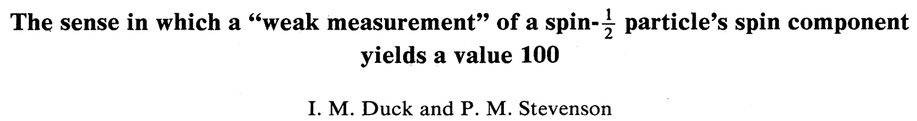
Introduction to weak values
Weak measurement:

Slide 34

Introduction to weak values
Weak measurement:

Slide 35
Introduction to weak values
Weak measurement:
For a real valued detector function

Slide 36

Introduction to weak values
Weak measurement:
For a real valued detector function

Slide 37
IS THE WEAK VALUE ALWAYS WEAK?

Slide 38
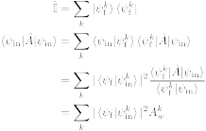
Is the weak value always weak?
Expectation value:

Slide 39
Is the weak value always weak?
Expectation value:

Slide 40
Is the weak value always weak?
Expectation value:

Slide 41
Is the weak value always weak?
Expectation value:

Slide 42
Is the weak value always weak?
Expectation value:

Slide 43
Is the weak value always weak?
Expectation value:

Slide 44
CAN WEAK VALUES DESCRIBE INTERFEROMETRY?

Slide 45



Weak values and interferometry
Standard interferometry formalism

Slide 46
Weak values and interferometry
Standard interferometry formalism

Slide 47
Weak values and interferometry
Standard interferometry formalism

Slide 48
Weak values and interferometry
Standard interferometry formalism

Slide 49
Weak values and interferometry
Standard interferometry formalism

Slide 50
Weak values and interferometry
Standard interferometry formalism

Slide 51

Weak values and interferometry
Standard interferometry formalism
Measured intensity

Slide 52
Weak values and interferometry
Weak value picture
Pre-selection

Slide 53
Weak values and interferometry
Weak value picture
Pre-selection
Interaction

Slide 54

Weak values and interferometry
Weak value picture
Pre-selection
Interaction

Slide 55
Weak values and interferometry
Weak value picture
Pre-selection
Interaction
Post-selection

Slide 56
Weak values and interferometry
Weak value picture
Measured intensity

Slide 57
Weak values and interferometry
Weak value picture
Measured intensity

Slide 58
Weak values and interferometry
Weak value picture
Measured intensity

Slide 59
Weak values and interferometry
Weak value picture
Measured intensity
Path weak value

Slide 60
Weak values and interferometry
Weak value picture
Measured intensity

Slide 61
Weak values and interferometry
Weak value picture
Measured intensity

Slide 62
Weak values and interferometry
Weak value picture
Measured intensity

Slide 63
Weak values and interferometry
Weak value picture
Measured intensity
Amplitude
square

Slide 64
Weak values and interferometry
Weak value picture
Measured intensity
Real part
Amplitude
square

Slide 65
Weak values and interferometry
Weak value picture
Measured intensity
Real part
Amplitude
square
Imaginary
part

Slide 66

Weak values and interferometry
Weak value extraction

